Slide 1
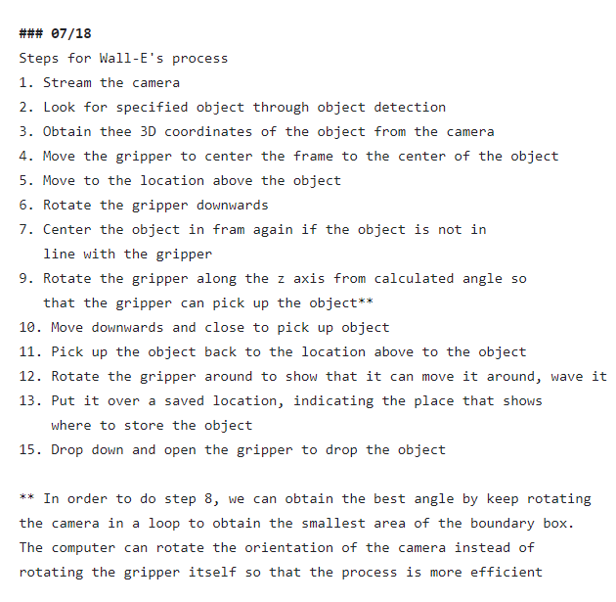
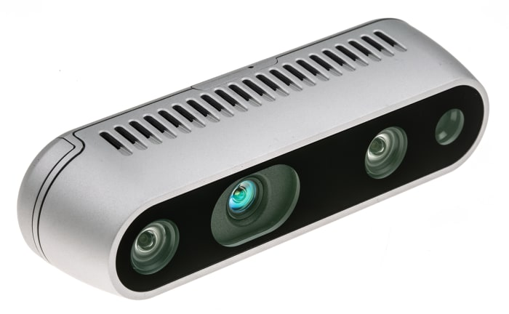

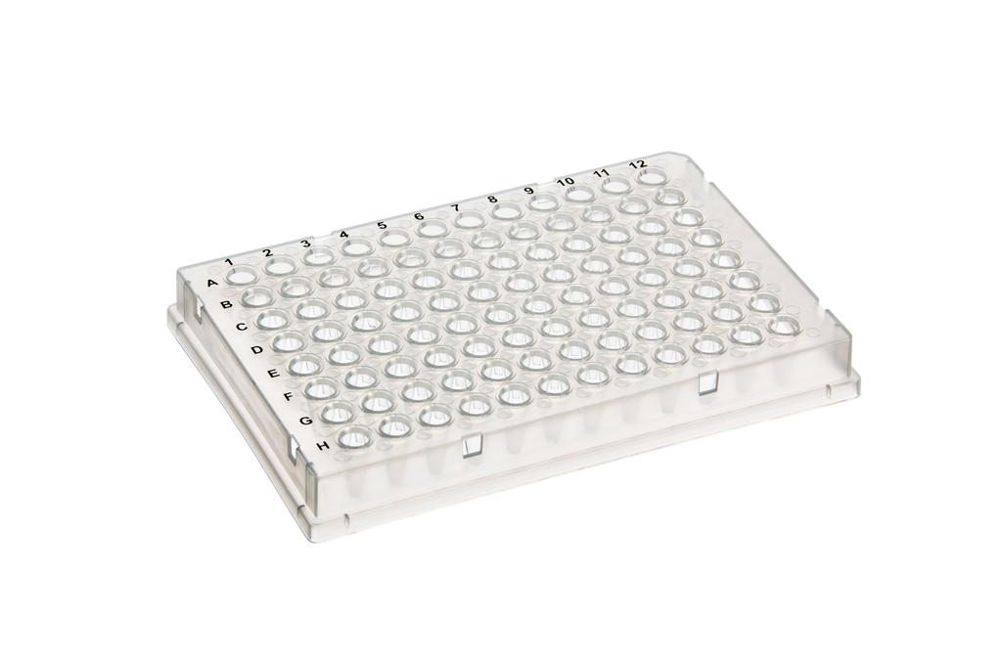
Alex’s Update Slides 7/27/23
This Week’s Progress
We can line up the camera with the object
Rotate the gripper downwards to “picking up position”
It can move the gripper above the object (d2) but not accurate
Goal for Next Week
Align object with gripper more accurately
Rotate gripper to pick up object
Pick up object and move around
Move to saved location
d2
Goal
The camera needs to measure the distance to an object so that the URX can grab it and place it into a container for organization
Notes:
We’re obtaining the 3D coordinates for two reasons, to align up the gripper and the object to grab it, and to calculate the distance right above the object. Since they are in the same plane once we aligned them, we only need to worry about 2 dimensions. Now, if we look at the picture, we can do trigonometry to find the distance since we know the angle of the camera front he intrinsic values from the robot and the distance from the object to the camera.

